Slide 1

Mazingira Bora Hackathon Challenge
By

Slide 2
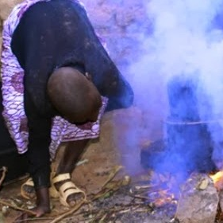
Did you know?
Did you know that many people in slums and rural areas cannot afford electricity? They end up using energy that is not clean like
Kerosene or firewood which is not good for their health and environment?

Slide 3
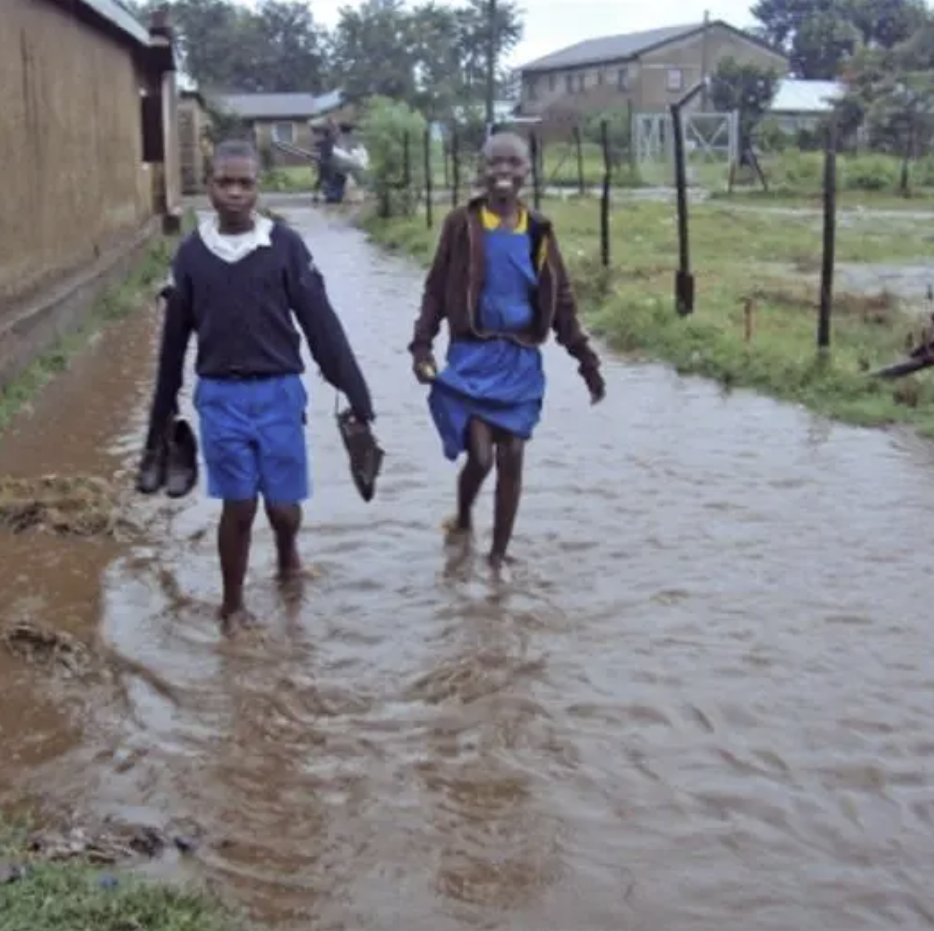
Did you know?
Did you know that many people in slums and rural areas cannot access clean drinking water during floods and drought? This can cause water borne diseases such as cholera that can affect the entire school or community.

Slide 4
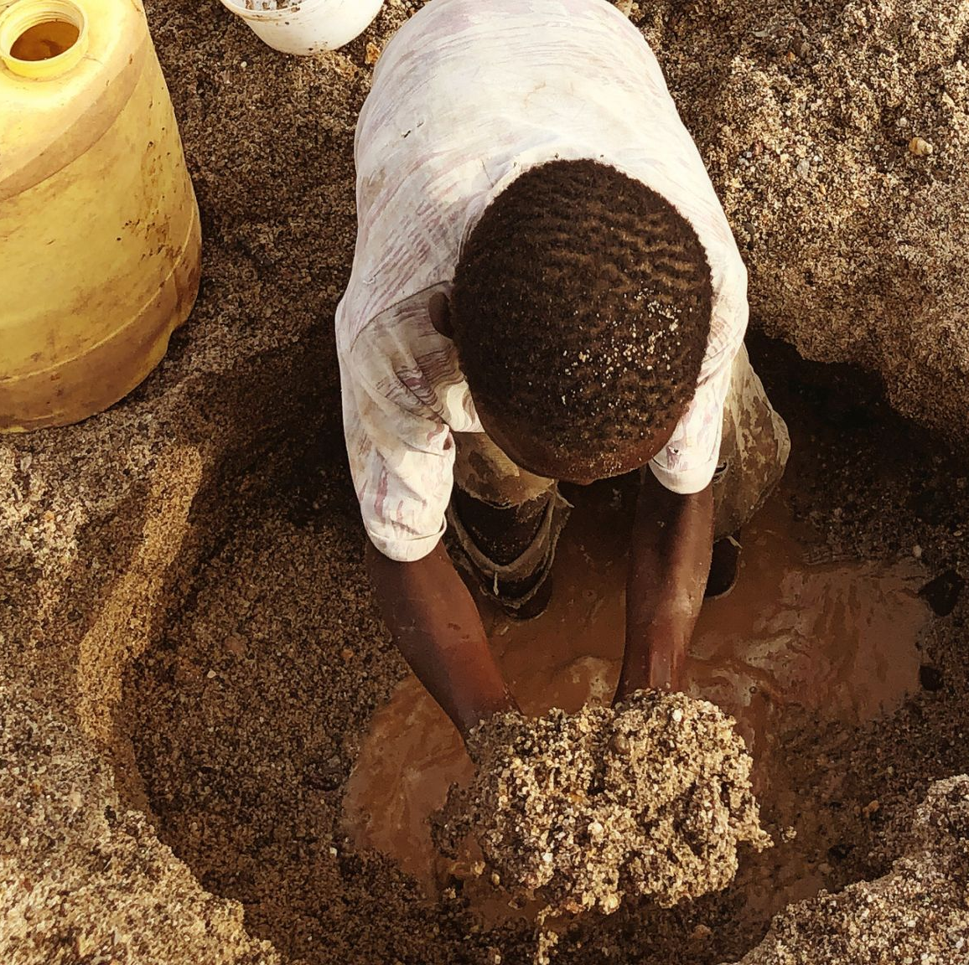
Challenge Introduction
Lack of clean drinking water in these areas is a huge problem during the occurrences of drought and floods and other environmental disasters. Often, it takes a long time to transport potable water to these areas resulting in health issues to the local residents.

Slide 5
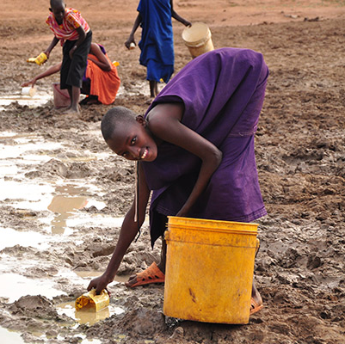
The Challenge
a solar power based water purification system using a cartridge heater to produce clean drinking water in these affected areas or remote areas where potable water is difficult to obtain can bridge the gap.
This water purification system uses a distillation technique, with an automatic valve which fills up a tank and heats up the water. The steam is captured and flowed into a clean water holding tank. This project could provide a good solution for providing clean drinking water to areas affected by floods.

Slide 6
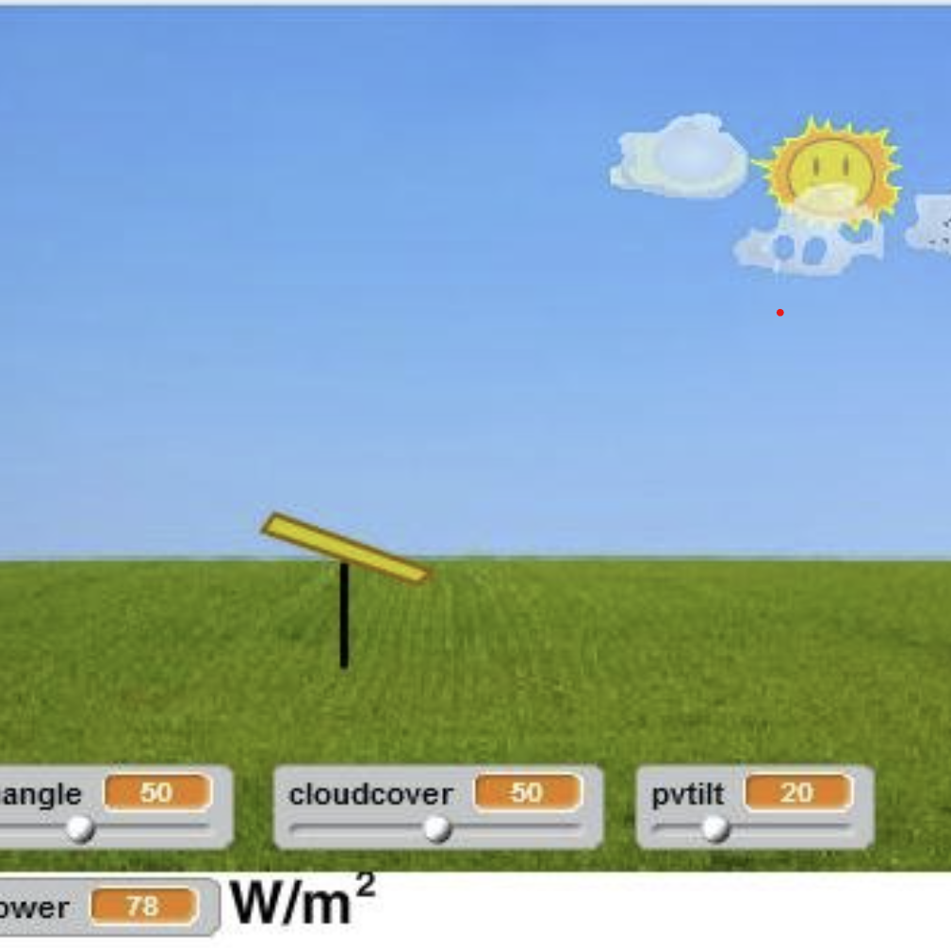
Challenge 1 (Ages: 4-17 Yrs )
Using scratch or any other programming language, automate the logical processes involved in the water purification and light energy storage.
Guidelines
First sketch the logical flow on how the process works on a pad or paper.
Choose the theme, images and styles to be used.
Using blocks available create a sequence, animation, motion and any other to illustrate step by step how it works.
Please see logical process sample diagrams to guide you.

Slide 7
Scoring
Item # | Item Description | Remarks | Score
1 | Creative thinking & Understanding
2 | The quality of flow diagram/sketch
3 | Easy to understand (User friendly)
4 | Critical thinking attributes

Slide 8
Challenge 2 (Ages: 4-17 Yrs )
Animate/Draw awareness campaign on clean water and clean energy sources using scratch or any other tools you are familiar with.
Guidelines
Should be simple, relevant and easy to understand.
Art based drawings using relevant resources such as paint, canvas etc.
Must be big enough for someone to see the message (Medium to Large Canvas will be appropriate)
Use any of the following forms to present your awareness
  Scratch or any other programming language
  Computer Graphics
  Draw/Sketch using computer tools/resources
  Use medium to large canvas with painting tools
  The use of color, font, font size, placement and alignment of elements is consistent.

Slide 9
Scoring
Item # | Item Description | Remarks | Score
1 | Creative thinking
2 | Simple and easy to understand (Useful Information)
3 | Clear drawing/animation
4 | Color Balance and Text Styling

Slide 10
Challenge 3 (Ages: 9-17 Yrs )
Using software tools create an interactive easy to understand lesson creating awareness on the importance of clean energy and water.
Guidelines
Use the following guidelines if you choose this challenge
  Should be relevant and suitable for the specific area of clean energy and water.
  Should be simple, easy to use, intuitive and relatively easy to navigate without guidance.
  Use of sound and images the lesson interactive.
  Include simple multiple choice assessment questions with a simple report.
  Use any of the following forms to present your lesson.
      Scratch or any other programming language
      HTML and CSS
      Video
      Animation
  Should generally open on many devices such as PCs, tablets and smart phones.

Slide 11
Scoring
Item # | Item Description | Remarks | Score
1 | Easy to use interface (User friendly)
2 | Navigation Elements
3 | Interactive elements such as sound, video and animations used.
4 | Accessible on different devices such Smart Phone, PC and Tablet.

Slide 12

Challenge 4 (Ages: 9-17 Yrs )
With the free sun almost every day, using a solar powered system, we can tap this clean energy by purifying water as well as charging and storing light energy to be used by schools or homes at night.
Use a smartboard like Raspberry pi or any other available to write a program that will collect and store energy amounts available, used and amount of water purified through the system. Using mobile network, send the data to central database for storage and analysis.

Slide 13
Challenge 4 (Ages: 9-17 Yrs )
Guidelines
Draw/Sketch Flow Diagram from start to finish. You can use a drawing pad or paper. See example of a flow diagram here
You can use any programming language you are familiar with such as scratch, snap, python etc.
More details on this can be provided by the challenge team if required.

Slide 14
Scoring
Item # | Item Description | Remarks | Score
1 | Creative thinking
2 | Communication & Collaboration
3 | Sketch quality
4 | Planning & Implementation
5 | Innovation Potential

Slide 15
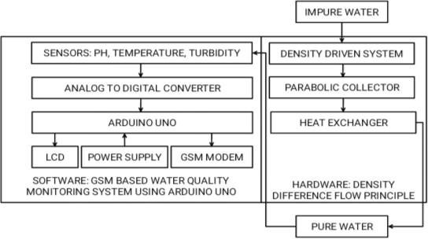
Additional Guidelines & Resources
Data Flow Diagram Example

Slide 16
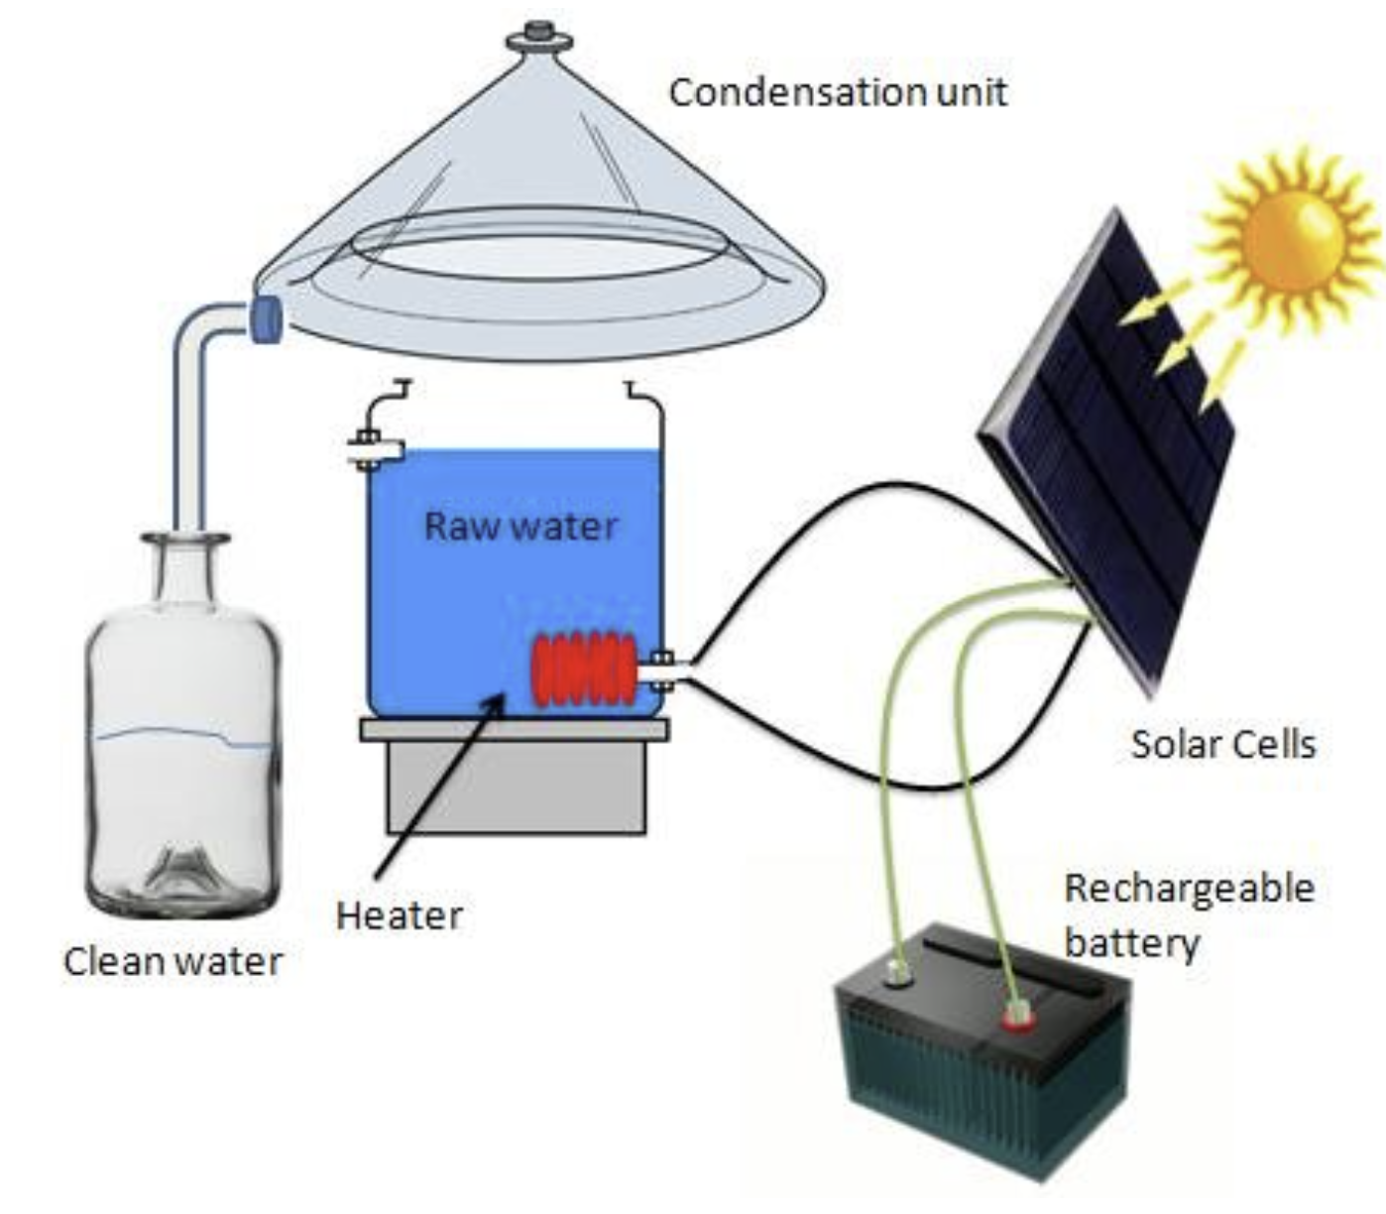
Additional Guidelines & Resources
Logical Process Example

Slide 17
Additional Guidelines & Resources
Programming Languages
https://scratch.mit.edu/ (Block based programming)
https://www.python.org/ ( Higher level coding for automation)
https://www.w3schools.com/html/default.asp (HTML5 + CSS)

Slide 18
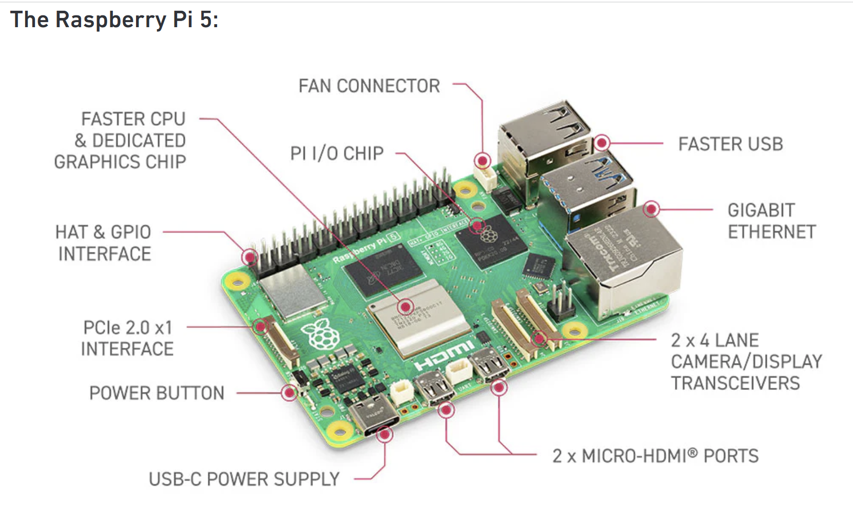
Additional Guidelines & Resources
https://www.raspberrypi.com/ (Smart Boards)

Slide 19
Additional Guidelines & Resources
Drawing & Sketching
https://docs.google.com/drawings/
Image Editing (Free)
https://inkscape.org/release/
https://www.gimp.org/
Videos Editing (Free)
https://www.openshot.org/
Interactive Content (Trial)
https://www.articulate.com/360/

